Slide 1
IMDB Movie Analysis
Sethuraman B

Slide 2

Project Description
In this project we are required to access the data from IMDB and generate insights on the questions asked by the team. The process is:
What’s Happening
Filter the data
Identifying the problem
Generate the insights

Slide 3
APPORACH
"Gaining insight into the dataset by utilizing Excel and comprehending its contents."
Tech-Stack Used
Accessing the dataset using Excel and understanding what’s happening in it.

Slide 4
Insights
Clean the data
For cleaning first we remove duplicate values which was 45 values and 4998 unique values remains
Blank spaces or null values clears
Remove extra space
Delete color column which does do not provide any values related to dataset.

Slide 5
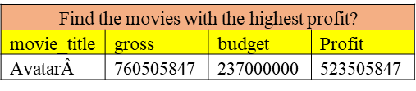
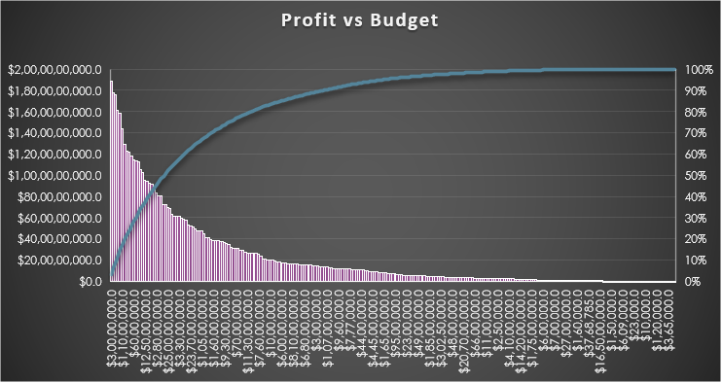
Insights Movies with Highest Profit:-
As per the charts, Avatar has the highest profit among all the movies of $523,505,847

Slide 6
Insights Find IMDB Top 250
As per the chart Top 250, Number 1 score is Avatar and last 250 is Fantastic four

Slide 7
Insights Find the Best Top 10 director w.r.t imbd rating
Director_Name | Average Imbd
Christopher Nolan | 8.425
Richard Marquand | 8.4
Sergio Leone | 8.433333
Alfred Hitchcock | 8.5
Tony Kaye | 8.6
Ron Fricke | 8.5
Damien Chazelle | 8.5
Charles Chaplin | 8.6
Asghar Farhadi | 8.4
Akira Kurosawa | 8.7
Majid Majidi | 8.5
According to the insights, top 1st Director is Akira Kurosawa

Slide 8
Insights
Find popular genres
Name of the movie | Popularity
Action | 959
Adventure | 781
Drama | 1893
Animation | 196
Comedy | 1461
Mystery | 384
Crime | 709
Biography | 239
Fantasy | 507
Documentary | 45
Sci-Fi | 496
Horror | 392
Romance | 858
Family | 442
Western | 59
Musical | 96
Thriller | 1115
History | 149
Music | 151
War | 152
Sport | 148
Film-Noir | 1
“As per the given chart, Popular Genres is drama.”

Slide 9
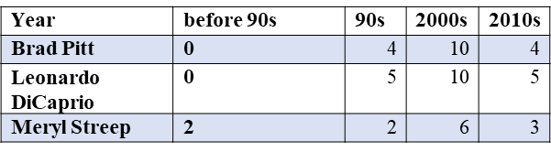
Insights
Finding Critic favourites and User favourites:
According to the Critic Reviews, Leonardo DiCaprio is the most favourite actor for critics
According to the User Reviews, Brad Pitt is the most favourite actor for Users
User Reviews

Slide 10
Result
The team asked for these specific insights and results, and we learned the significance of data filtering and how to create more comprehensive insights for the mentioned issue through this project.
Excel Link: https://docs.google.com/spreadsheets/d/1zQTNaPMiJgfXQrowL3jLHFKQ0U4nQD_J/edit?usp=sharing&ouid=108433007974397532023&rtpof=true&sd=true

Slide 11
These are the required insights and the result which were asked by the
team. From this project we learnt the need of data filtration and how to
generate deeper insights for a problem mentioned…

